Slide 1


ATLIQ MART
Supply Chain Analysis for FMCG Domain
Jamilya SEISEMBEKOVA
Rayan KAROUT
Rim BOUGHANMI

Slide 2

Problem Description
Delivering Excellence, Every Time
AtliQ Mart, a growing FMCG manufacturer based in Gujarat, India, is on the cusp of expansion into new markets within the next two years. However, the company faces a critical challenge: certain key customers are not renewing their contracts due to service issues. These issues stem from potential delays or incomplete deliveries of essential products, leading to compromised customer satisfaction.

Slide 3
ATLIQ MART
Performance Metrics
OT %
IF %
OTIF %
ON TIME DELIVERY
IN FULL DELIVERY
ON TIME IN FULL
Number of orders delivered On Time / Total Number of Orders
Number of orders delivered in Full quantity / Total Number of Orders
Number of orders delivered both IN Full & On Time / Total Number of Orders

Slide 4
ATLIQ MART
Performance Metrics
LIFR %
VOFR %
LINE FILL RATE
VOLUME FILL RATE
Number of order lines shipped In Full Quantity / Total Order Lines
Total Quantity shipped / Total Quantity Ordered

Slide 5
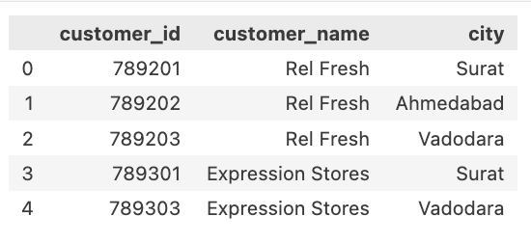

ATLIQ MART
Data set and explanation
The dim_customers dataset provides essential information about customers associated with AtliQ Mart's supply chain operations. Here's a breakdown of the columns:
customer_id: Unique identifiers for each customer.
customer_name: Names of the customers associated with AtliQ Mart.
city: Geographical location of each customer.

Slide 6
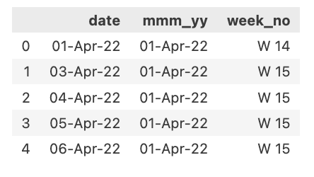
ATLIQ MART
Data set and explanation
The date column set the columns offer crucial temporal information for analysis. The date column provides specific calendar dates, mmm_yy offers concise month and year representation, and week_no organizes dates into weekly intervals, aiding in trend identification and temporal analysis.
date: This column denotes specific calendar dates.
mmm_yy: Indicates the month and year in a concise format (MMM YY).
week_no: Represents the week number corresponding to each date.

Slide 7
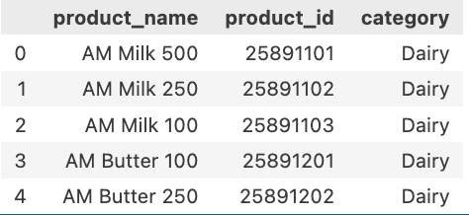
ATLIQ MART
Data set and explanation
The Products data set the columns provide essential details about the products offered by AtliQ Mart, including their names, unique identifiers, and categorization into specific product categories. This information aids in product management, inventory tracking, and analysis within the supply chain.
Product_name: Names of the products available, such as AM Milk 500 etc..
product_id: Unique identifiers assigned to each product.
category: Indicates the category to which each product belongs, such as "Dairy".

Slide 8
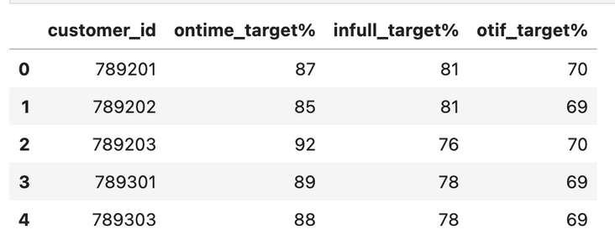
ATLIQ MART
Data set and explanation
The dim_targets_orders dataset provides information about number of orders delivered
ontime_target%: percentage of orders delivered on time of each customer_id
infull_target%: percentage of orderes delivered in full quantity
otif_target%: percentage of orderes delivered both on time and in full

Slide 9
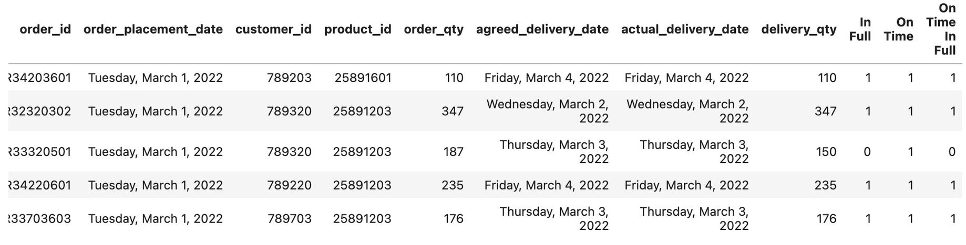
ATLIQ MART
Data set and explanation
The fact_order_lines dataset provides essential information about order lines. This dataset has dates as order placement, agreed delivery and actual delivery date of each order

Slide 10
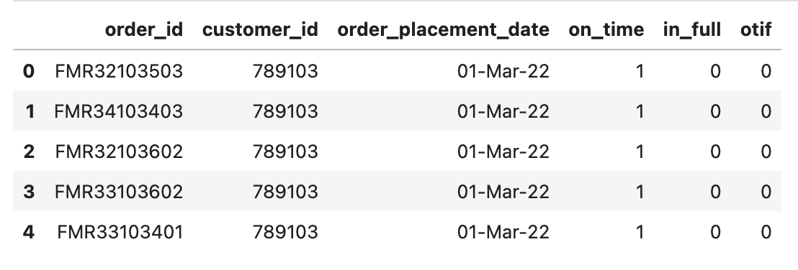
ATLIQ MART
Data set and explanation
The fact_orders_aggregate dataset provides essential information about orders

Slide 11

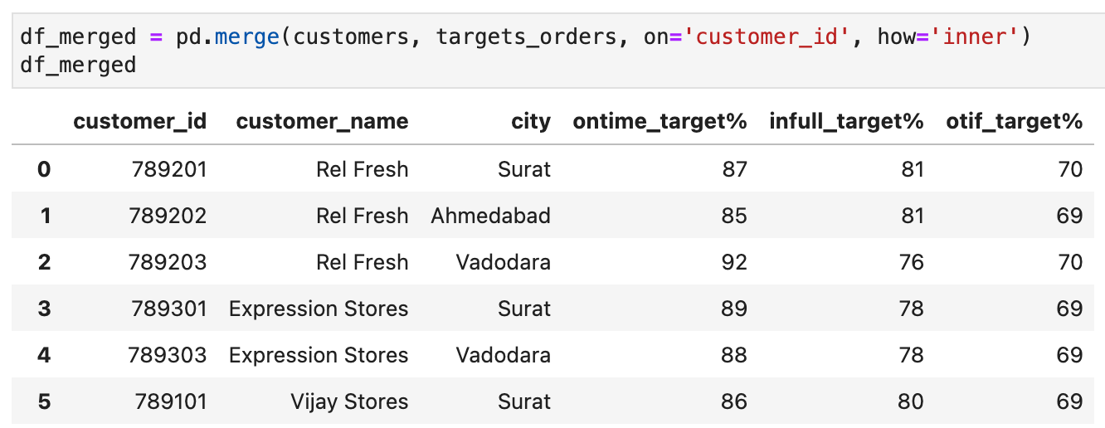
ATLIQ MART
Data Manipulation
The datasets were merged to be extracted for PowerBI dashboard development

Slide 12
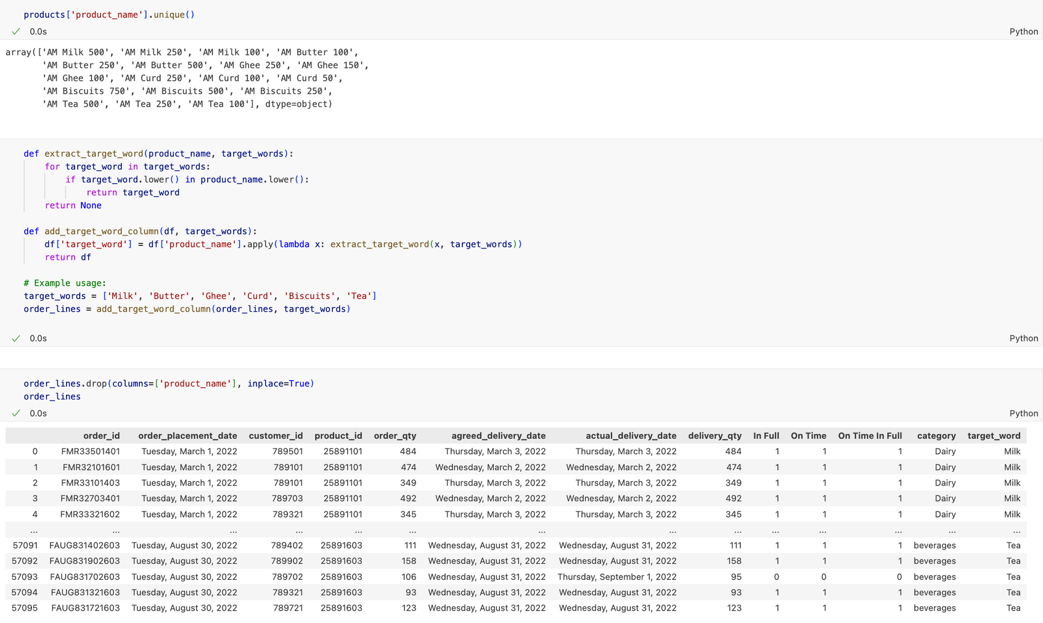
Data Manipulation
ATLIQ MART

Slide 13

Data Visualization and Metrics

Slide 14
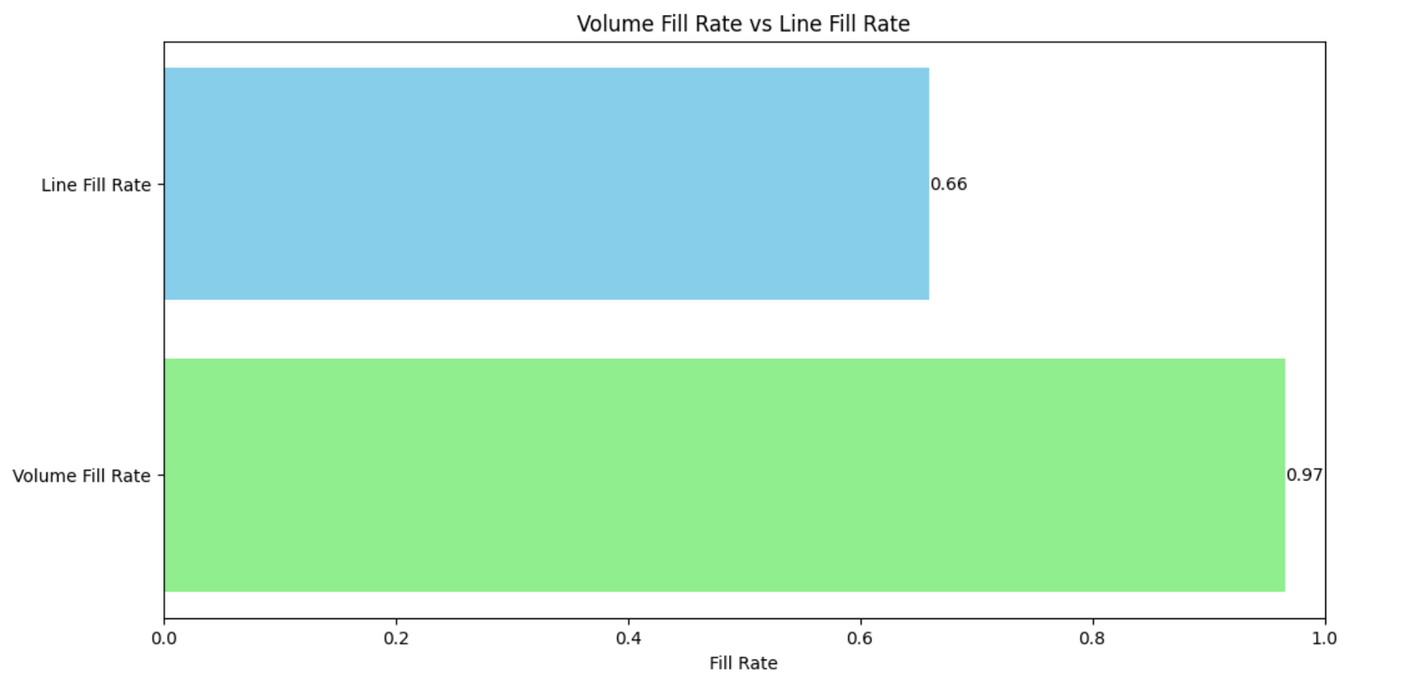
ATLIQ MART
ATLIQ MART
Comparison of Volume Fill Rate and Line Fill Rate

Slide 15
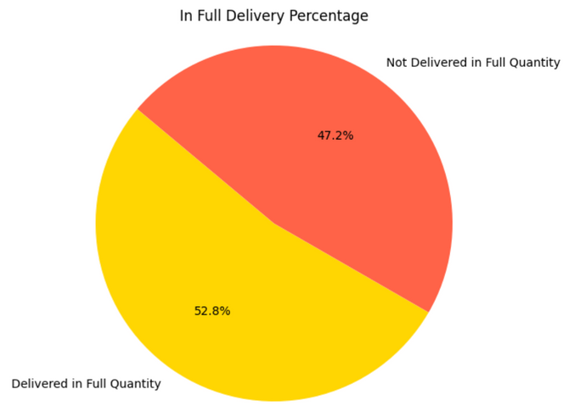
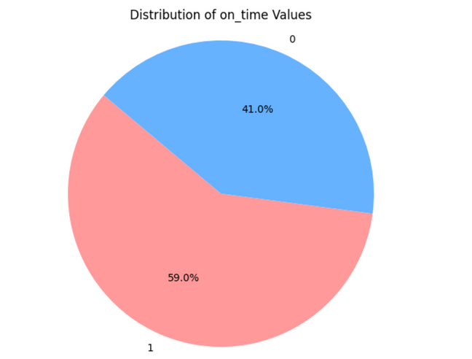
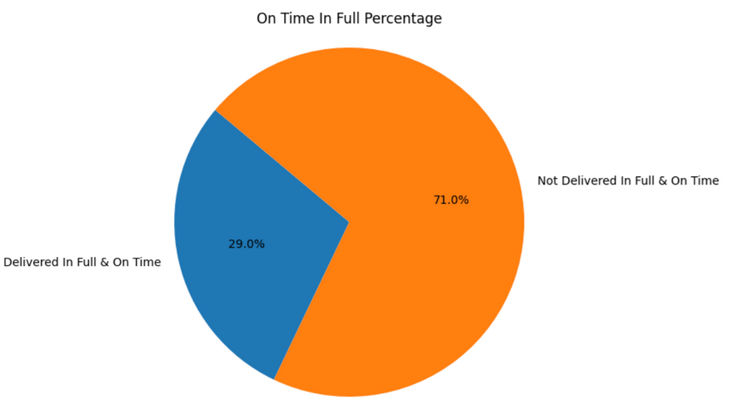
ATLIQ MART
ATLIQ MART
59% deliveries were on time
52% of deliveries were delivered in full
29% were delivered on time and In full

Slide 16
Predictive modeling

Slide 17
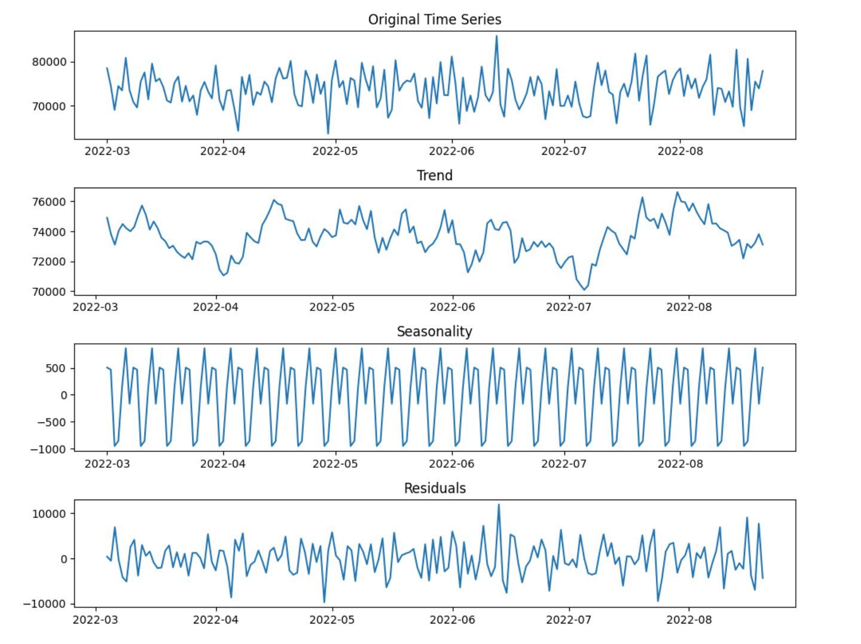
ATLIQ MART
ATLIQ MART

Slide 18
ATLIQ MART
Interpretation
- Clear seasonality without a discernible trend.
- Predictable fluctuations influenced by seasonal factors.
- No consistent long-term increase or decrease.
- Essential for accurate forecasting and strategic planning.
- Enables capitalization on peak periods.
- Crucial for staying responsive to changing market conditions.
ATLIQ MART

Slide 19
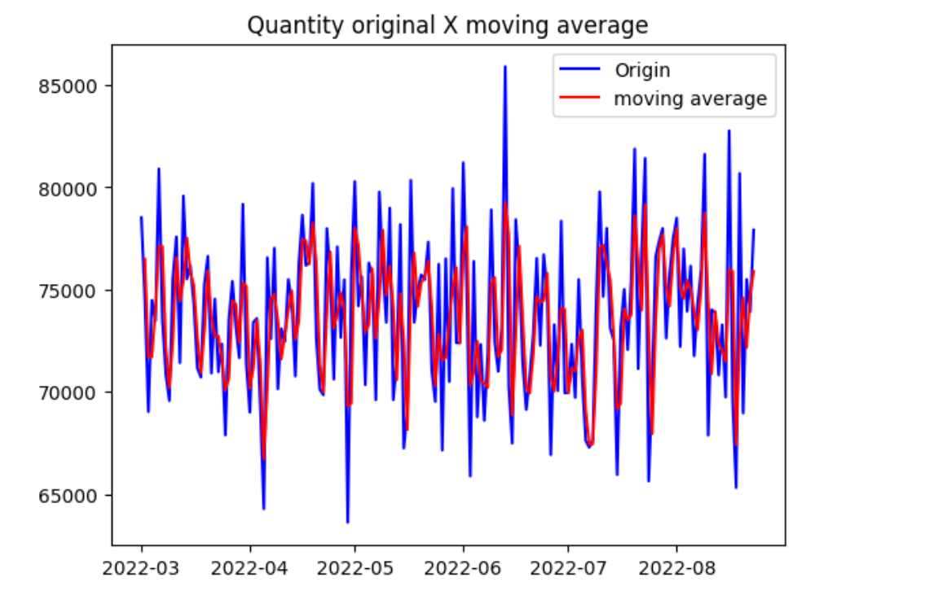
ATLIQ MART
ATLIQ MART

Slide 20
Interpretation
ATLIQ MART
- Moving average analysis reveals slightly diminished peaks of fluctuation compared to the original data.
- Peaks are smoothed out, leading to a more stable representation of the underlying pattern.
- Despite smoothing, general trajectory and patterns of the original data remain preserved.
- Moving average offers a filtered view, emphasizing underlying trends while reducing short-term variability.
ATLIQ MART

Slide 21
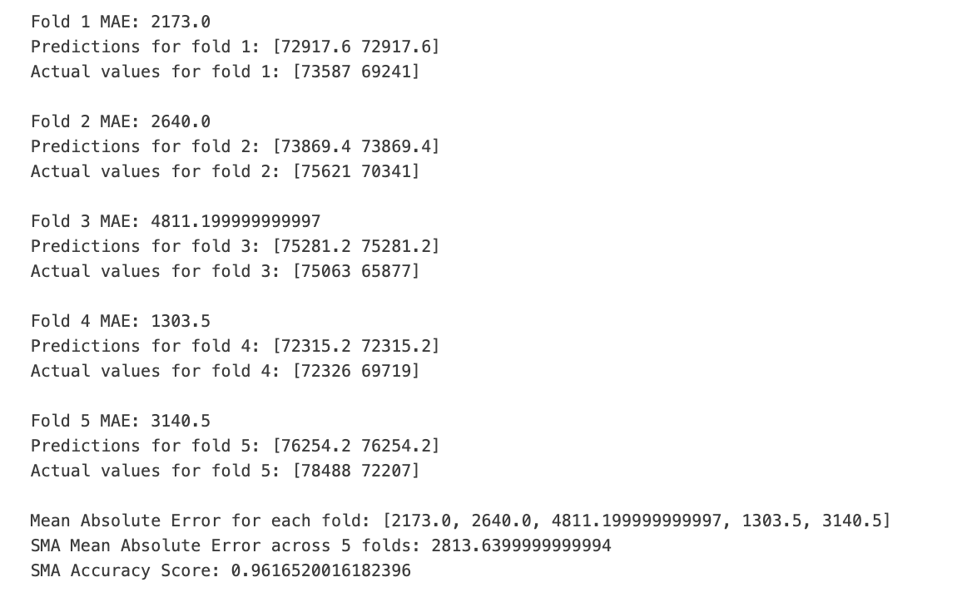
Simple Moving Average
ATLIQ MART
ATLIQ MART

Slide 22
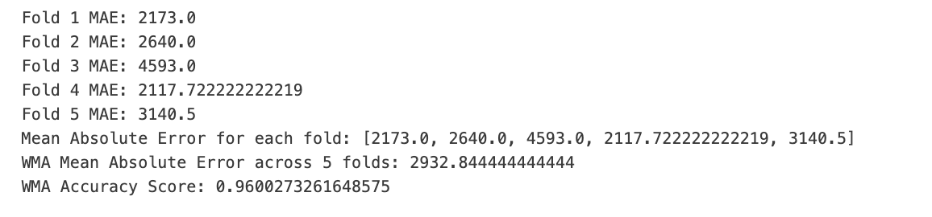
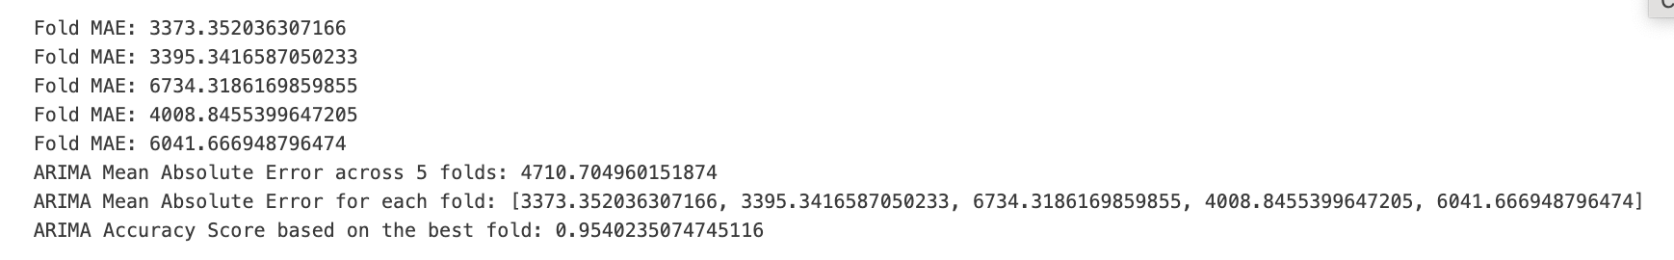
Weighted Moving Average
ATLIQ MART
ARIMA
ATLIQ MART

Slide 23

Dashboards

Slide 24
Recommendations
ATLIQ MART
OTIF ‘Hard’ metric:
Approximately 36,6 % , meaning it cannot fully meet customer demand in all cities
Optimize inventory levels, balance stock availability. This can be done by applying ABC/XYZ analysis to get the popularity of items and identify variability.
LIFR < VOFR (poor performance in delivering all requested products):
At least in demand season, ensure stock availability, by applying some forecast methods, especially for dairy products.
Vadodara has the lowest service level for all 5 measures:
We would recommend that Atliq Mart to start dignostic actions with Vadodara to improve service levels.
Biggest Clients that are facing issues:
Acclaimed Stores
Coolblue
Lotus Mart
ATLIQ MART
Atliq Mart should conduct a comprehensive analysis with the warehouse and distribution team to identify potential issues affecting these clients for their issues to be solved, and ensure contract extensions.

Slide 25
THANK YOU!

